Slide 1
ONE PERSON IN GROUP-> CLICK USE TEMPLATE
WHEN THE COPIED TEMPLATE OF THESE SLIDES OPENS IN A NEW TAB:
ADD YOUR Group NAME TO THE TITLE
SHARE WITH GROUP MEMBERS (USE SHARE BUTTON)
COPY THE TITLE AND LINK TO YOUR RECORDS (Digital folder/table of contents)
Remember it is advisable to make a PERSONAL copy and link it when DONE

Slide 2
Solubility Curves

Slide 3
ESSENTIAL QUESTIONS
Remember, you should be able to thoroughly answer these AFTER learning through following resources.
What are the different ways we can describe solutions based on their saturation?
What information does a Solubility graph provide?
What is the difference between a gas and a solid in aqueous solution as temperature rises?

Slide 4
Instructions
Follow through the Engage to Apply resources in order .
Once complete, choose from Extend resources as interested.
Record your learning in these slides- Remember to keep track of where to find these slides for studying!
Complete the Essential Questions Response in the Apply Section.
Try the Extend section and optional Apply practice as desired to deepen your understanding

Slide 5
Hyperdoc Elements
Click for quick access to:
Engage
Explore
Apply
Extend

Slide 6
Terminology - As you encounter terms new to you, define in your own words here, include examples (make them up!)

Slide 7
Part 1: ENGAGE
(5 minutes)

Slide 8
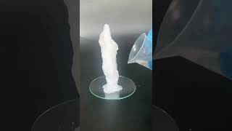
Engage
Watch the video on the right about cold ice with your group and discuss the below:
Make three (3) observations and one (1) inference based on your observations about what the video shows.

Slide 9
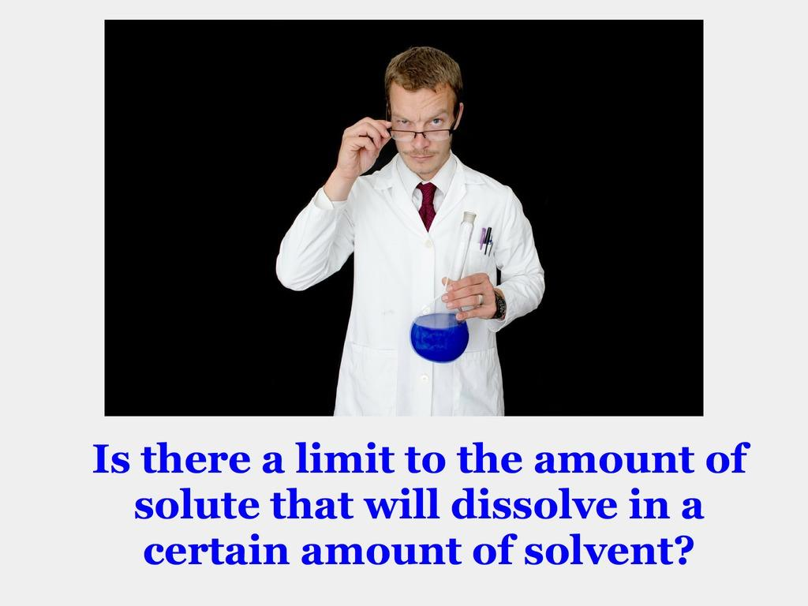
Discuss:

Slide 10
Part 2: EXPLORE

Slide 11
Explore: Solubility and temperature
The solubility of a compound is the maximum amount of solute that can be dissolved in a solvent for a given set of conditions (ie temperature, pressure, etc)
It is often expressed in terms of 100g of solvent (note the units!)

Slide 12
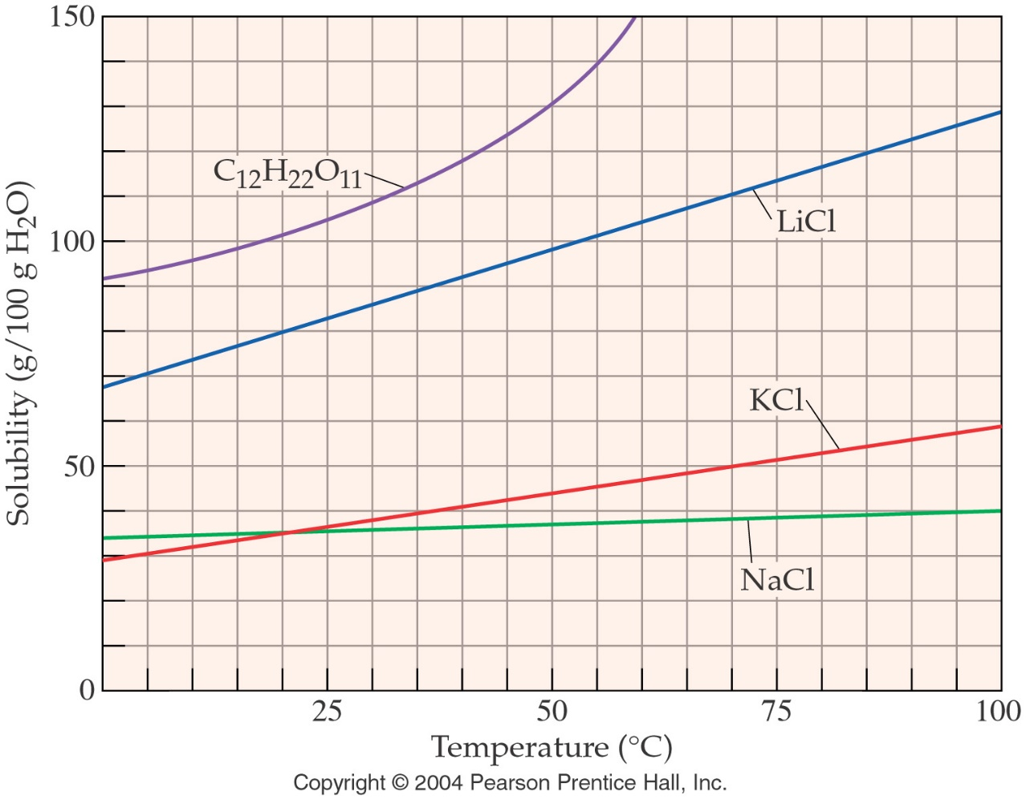
Explore: Describing Solubility
In general, a compound becomes more soluble as the temperature increases.
Come up with a few examples of solutions you heat to increase solubility (think drinks).

Slide 13
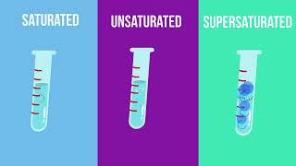
Explore: Types of Solutions
Unsaturated Solution: a solution contains less than the maximum amount of solute (i.e) more solute will dissolve
Saturated Solution: contains maximum amount of solute that can be dissolved in a given amount of solvent at a certain temperature.
Supersaturated Solution: a solution that contains more dissolved solute than it would usually support. They are very unstable and adding more solute will cause crystallization
Unsaturated Solution: As a group come up with a definition then move this box to compare
Supersaturated Solution: As a group come up with a definition then move this box to compare
Optional: watch the video to enhance understanding

Slide 14
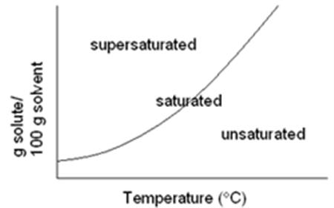
Explore: Describing Solubility
Point on the line is saturated
Point above the line is supersaturated
Point below the line is unsaturated
Label the above and below the line blue boxes as unsaturated or supersaturated. Discuss your reasoning as a group, then check your understanding by moving all blue boxes)

Slide 15
Explore: Solubility and temperature
For this graph, answer on the next slide:
What is the solvent and its quantity?
What is the solubility of LiCl at 50ºC?
At what temperature is a solution with KCl considered saturated at 50/100g H2O?
At what minimum concentration will NaCl be considered supersaturated regardless of temperature?

Slide 16
Room for Graph Answers
* include your explanations

Slide 17
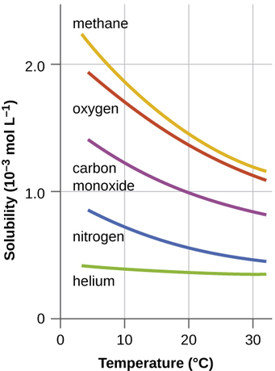
Explore: Solubility and temperature
The following compounds are all gases.
What do you notice that is different about the trends of gases as compared to trends of ionic solids?
Discuss with your group why this might be (feel free to write in your thoughts)

Slide 18

Explore: Solubility and temperature
Can you predict what will happen when Grandma drops the mentos into her pop? Can you explain it! (1 minute)

Slide 19
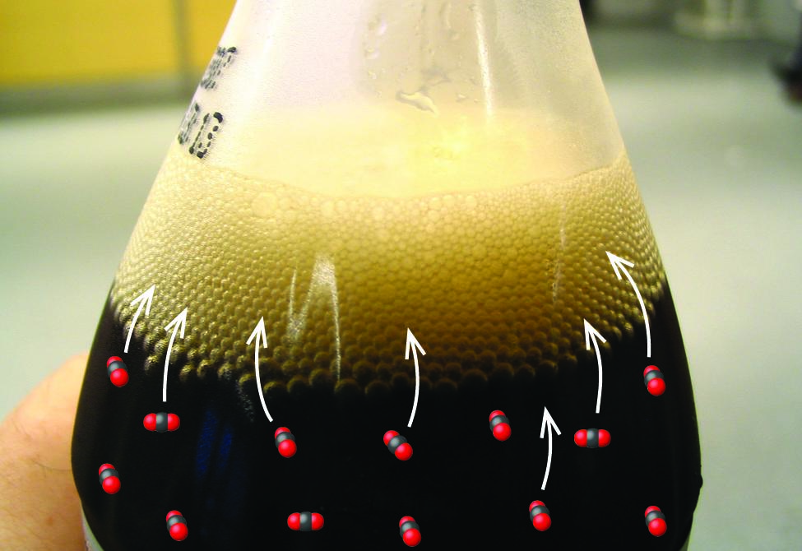
Explore: Solubility and temperature
Opening the bottle of carbonated beverage reduces the pressure of the gaseous carbon dioxide above the beverage. The solubility of CO₂ is thus lowered, and some dissolved carbon dioxide may be seen leaving the solution as small gas bubbles.

Slide 20
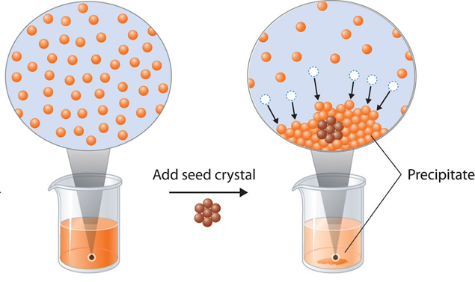
Supersaturated Solutions
These solutions contain more dissolved solute than a saturated solution at the same temperature
These can be created by heating them up, and allowing them to cool, or using pressure if the solute is a gas
If done carefully, the dissolved solute will stay dissolved as the solution cools
These solutions are unstable and if disturbed, the excess solute will be removed from solution
Example: adding seed crystal or using physical force

Slide 21
Part 3: Apply

Slide 22
Supersaturated Solutions
Recall (or revisit) the video of cold ice from the engage section.
Can you now identify what type of solution was used and what occurred as it was poured? Explain!

Slide 23

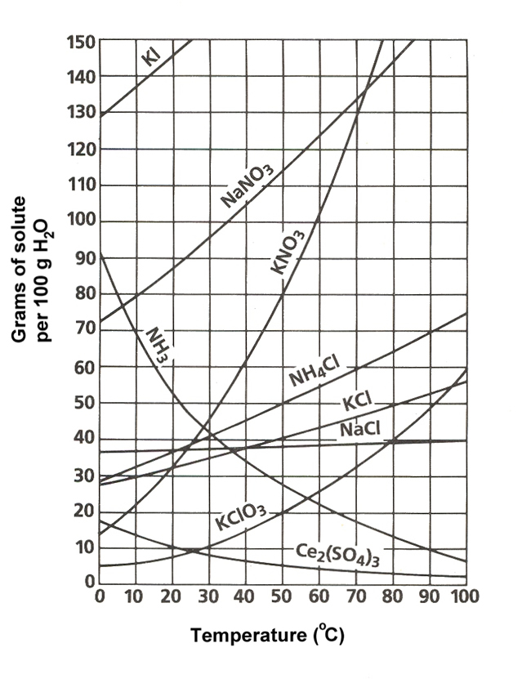
Solubility Curve Questions
What is the solubility of KCl at 70°C?
How many grams of KClO₃ will dissolve in 100 grams of water at 40°C ?
How many grams of KClO₃ will dissolve in 50 grams of water at 40°C?
Share your answers with your teacher! Check answer slides a the end.

Slide 24
Factors Affecting Rate of Dissolving
The factors that affect rate of dissolving are:
Stirring
Temperature
Surface area
Choose one (1) of these factors and at the boards, draw diagram(s) that includes IMF to explain how they affect the rate of dissolving. Take a picture for the next slide

Slide 25
Factor(s) of dissolving Board Photo

Slide 26
Collaborate!
Share your factor drawing with another group. Record an explanation here of at least one other factor’s impact on dissolving after learning from another group.

Slide 27
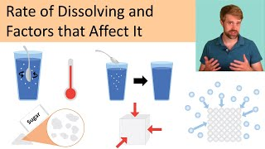
Factors Affecting Rate of Dissolving
Watch the video on the right.
For your chosen factor, make additional annotations or adjustments in a different colour based on any new information you needed to add to complete your response.

Slide 28
Continue Practice!
Complete any practice work off the unit plan to solidify your understanding.

Slide 29
Next few slides provide answers to activities

Slide 30
Solubility Curve Questions
What is the solubility of KCl at 70°C? 47 g
How many grams of KClO₃ will dissolve in 100 grams of water at 40°C ? 15 g
How many grams of KClO₃ will dissolve in 50 grams of water? 7.5g
15 g KClO₃ = x
100 g H₂O 50 g H2O

Slide 31
Part 4: Beyond the course extensions
{optional - none avail currently}

